Slide 1
TypeScript

Slide 2
Introduction
TypeScript is an open-source, object-oriented programing language, which is developed and maintained by Microsoft under the Apache 2 license. It was introduced by Anders Hejlsberg, a core member of the development team of C# language.
TypeScript is a strongly typed superset of JavaScript which compiles to plain JavaScript. It is a language for application-scale JavaScript development, which can be executed on any browser, any Host, and any Operating System.
TypeScript is not directly run on the browser. It needs a compiler to compile and generate in JavaScript file. TypeScript is the ES6 version of JavaScript with some additional features.

Slide 3
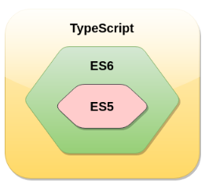
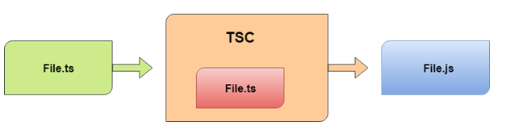
What is TypeScript?
TypeScript is an open-source pure object-oriented programing language. It is a strongly typed superset of JavaScript which compiles to plain JavaScript. It contains all elements of the JavaScript. It is a language designed for large-scale JavaScript application development, which can be executed on any browser, any Host, and any Operating System. The TypeScript is a language as well as a set of tools. TypeScript is the ES6 version of JavaScript with some additional features.
TypeScript cannot run directly on the browser. It needs a compiler to compile the file and generate it in JavaScript file, which can run directly on the browser. The TypeScript source file is in ".ts" extension. We can use any valid ".js" file by renaming it to ".ts" file. TypeScript uses TSC (TypeScript Compiler) compiler, which convert Typescript code (.ts file) to JavaScript (.js file).

Slide 4
History of TypeScript
In 2010, Anders Hejlsberg, a core member of the development team of C# language, started working on TypeScript at Microsoft. The first version of TypeScript was released to the public in the month of 1st October 2012 and was labeled as version 0.8. Now, it is maintained by Microsoft under the Apache 2 license. The latest version of Typescript is TypeScript 3.5, which was released to the public on May 2019.

Slide 5
Why use TypeScript?
We use TypeScript because of the following benefits.
TypeScript supports Static typing, Strongly type, Modules, Optional Parameters, etc.
TypeScript supports object-oriented programming features such as classes, interfaces, inheritance, generics, etc.
TypeScript is fast, simple, and most importantly, easy to learn.
TypeScript provides the error-checking feature at compilation time. It will compile the code, and if any error found, then it highlighted the mistakes before the script is run.
TypeScript supports all JavaScript libraries because it is the superset of JavaScript.
TypeScript support reusability because of the inheritance.
TypeScript make app development quick and easy as possible, and the tooling support of TypeScript gives us autocompletion, type checking, and source documentation.
TypeScript has a definition file with .d.ts extension to provide a definition for external JavaScript libraries.
TypeScript supports the latest JavaScript features, including ECMAScript 2015.
TypeScript gives all the benefits of ES6 plus more productivity.
Developers can save a lot of time with TypeScript.

Slide 6
Text Editors with TypeScript Support
The TypeScript was initially supported only in Microsoft's Visual Studio platform. But today, there are a lot of text editors and IDEs available which either natively or through plugins have support for the TypeScript programming. Some of them are given below.
Visual Studio Code
Official Free Plugin for Sublime Text.
The latest version of WebStorm
It also supports in Vim, Atom, Emacs, and others.

Slide 7
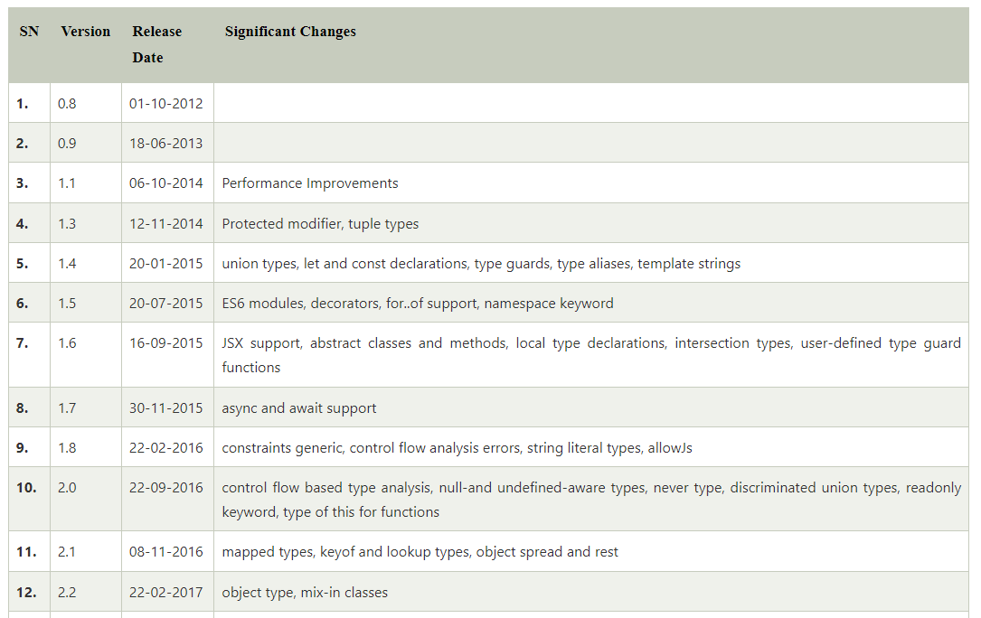
TypeScript Version

Slide 8
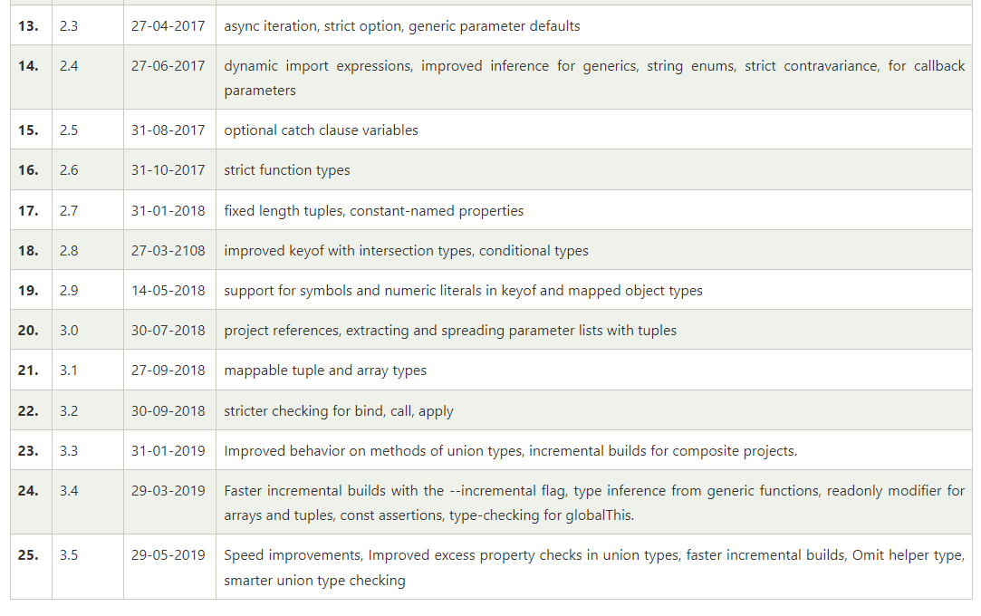
TypeScript Version

Slide 9
Difference between JavaScript and TypeScript
JavaScript
JavaScript is the most popular programming language of HTML and the Web. JavaScript is an object-based scripting language which is lightweight and cross-platform. It is used to create client-side dynamic pages. The programs in JavaScript language are called scripts. The scripts are written in HTML pages and executed automatically as the page loads. It is provided and executed as plain text and does not need special preparation or compilation to run.
TypeScript
TypeScript is an open-source pure object-oriented programing language. It is a strongly typed superset of JavaScript which compiles to plain JavaScript. TypeScript is developed and maintained by Microsoft under the Apache 2 license. It is not directly run on the browser. It needs a compiler to compile and generate in JavaScript file. TypeScript source file is in ".ts" extension. We can use any valid ".js" file by renaming it to ".ts" file. TypeScript is the ES6 version of JavaScript with some additional features.

Slide 10
Advantage of TypeScript over JavaScript
TypeScript always highlights errors at compilation time during the time of development, whereas JavaScript points out errors at the runtime.
TypeScript supports strongly typed or static typing, whereas this is not in JavaScript.
TypeScript runs on any browser or JavaScript engine.
Great tooling supports with IntelliSense which provides active hints as the code is added.
It has a namespace concept by defining a module.
Disadvantage of TypeScript over JavaScript
TypeScript takes a long time to compile the code.
TypeScript does not support abstract classes.
If we run the TypeScript application in the browser, a compilation step is required to transform TypeScript into JavaScript.

Slide 11
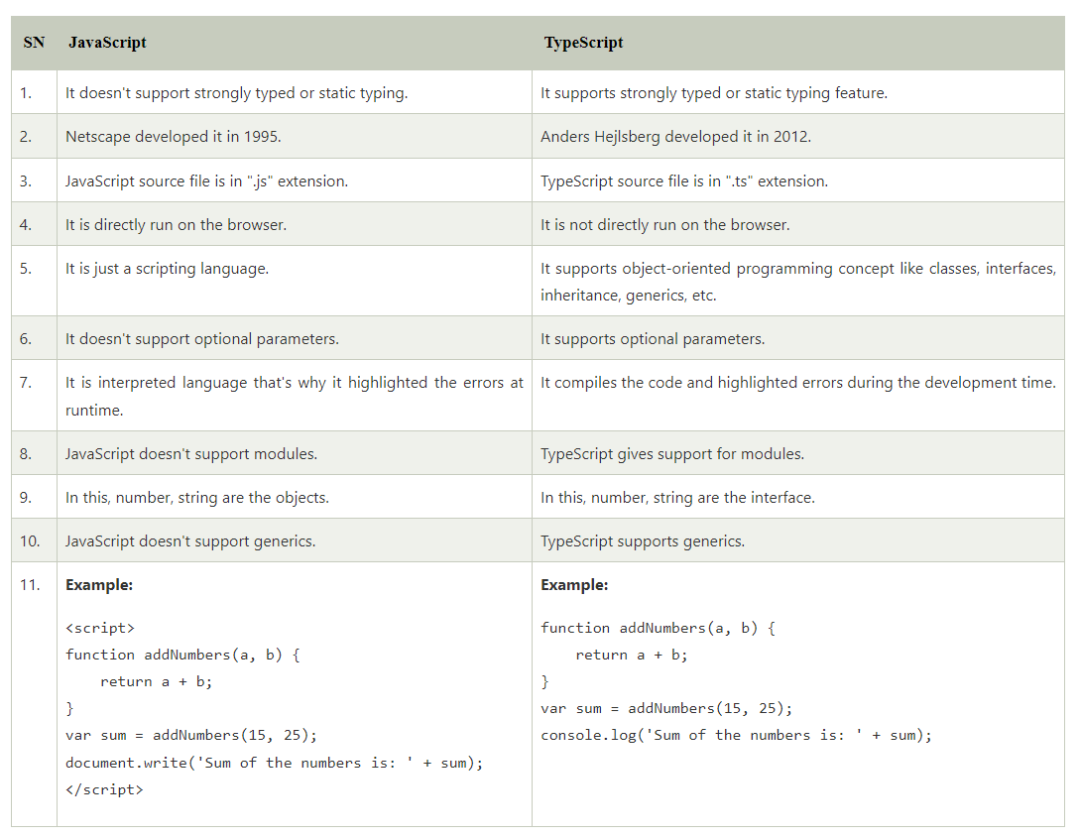
TypeScript Vs. JavaScript

Slide 12
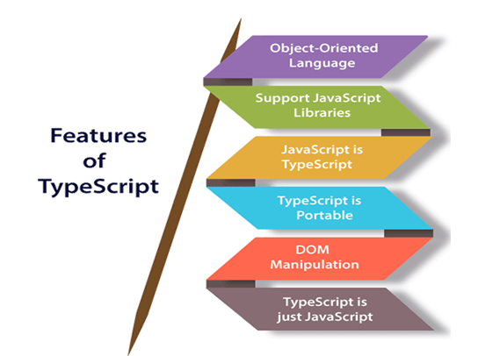
Features of TypeScript

Slide 13
Features of TypeScript
Object-Oriented language: TypeScript provides a complete feature of an object-oriented programming language such as classes, interfaces, inheritance, modules, etc. In TypeScript, we can write code for both client-side as well as server-side development.
TypeScript supports JavaScript libraries: TypeScript supports each JavaScript elements. It allows the developers to use existing JavaScript code with the TypeScript. Here, we can use all of the JavaScript frameworks, tools, and other libraries easily.
JavaScript is TypeScript: It means the code written in JavaScript with valid .js extension can be converted to TypeScript by changing the extension from .js to .ts and compiled with other TypeScript files.
TypeScript is portable: TypeScript is portable because it can be executed on any browsers, devices, or any operating systems. It can be run in any environment where JavaScript runs on. It is not specific to any virtual-machine for execution.
DOM Manipulation: TypeScript can be used to manipulate the DOM for adding or removing elements similar to JavaScript.
TypeScript is just a JS: TypeScript code is not executed on any browsers directly. The program written in TypeScript always starts with JavaScript and ends with JavaScript. Hence, we only need to know JavaScript to use it in TypeScript. The code written in TypeScript is compiled and converted into its JavaScript equivalent for the execution. This process is known as Trans-piled. With the help of JavaScript code, browsers can read the TypeScript code and display the output.

Slide 14
Components of TypeScript
The TypeScript language is internally divided into three main layers. Each of these layers is divided into sublayers or components. In the following diagram, we can see the three layers and each of their internal components.
These layers are:
Language
The TypeScript Compiler
The TypeScript Language Services

Slide 15
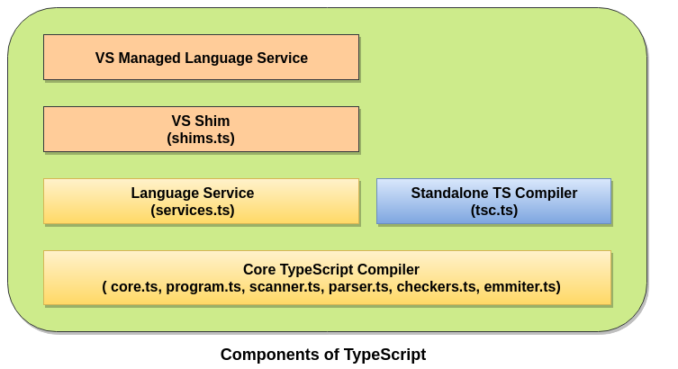
Components of TypeScript

Slide 16
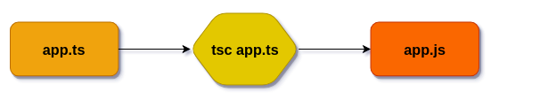
Components of TypeScript
1. Language
It features the TypeScript language elements. It comprises elements like syntax, keywords, and type annotations.
2. The TypeScript Compiler
The TypeScript compiler (TSC) transform the TypeScript program equivalent to its JavaScript code. It also performs the parsing, and type checking of our TypeScript code to JavaScript code.

Slide 17
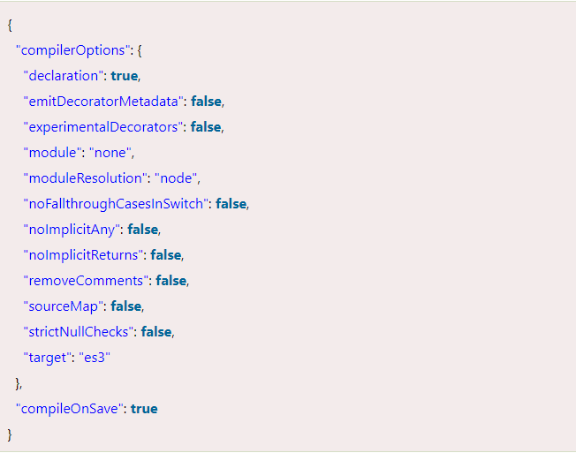
Compiler Configuration
The TypeScript compiler configuration is given in tsconfig.json file and looks like the following:

Slide 18
The TypeScript Language Services
The language service provides information which helps editors and other tools to give better assistance features such as automated refactoring and IntelliSense. It exposes an additional layer around the core-compiler pipeline. It supports some standard typical editor operations like code formatting and outlining, colorization, statement completion, signature help, etc.

Slide 19
TypeScript Installation
Install TypeScript. To install TypeScript, enter the following command in the Terminal Window.
$ npm install typescript --save-dev //As dev dependency
$ npm install typescript -g //Install as a global module
$ npm install typescript@latest -g //Install latest if you have an older version
To verify the installation was successful, enter the command $ tsc -v in the Terminal Window.

Slide 20
TypeScript First Program
function greeter(person) {
return "Hello, " + person;
}
let user = ‘Angular training';
console.log(greeter(user));

Slide 21
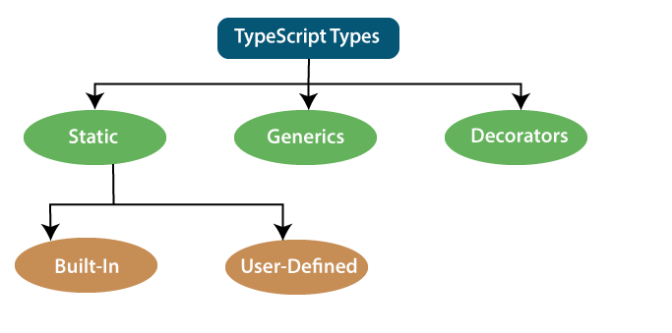
TypeScript Type
The TypeScript language supports different types of values. It provides data types for the JavaScript to transform it into a strongly typed programing language.

Slide 22
Static Types
In the context of type systems, static types mean "at compile time" or "without running a program." In a statically typed language, variables, parameters, and objects have types that the compiler knows at compile time. The compiler used this information to perform the type checking.
Static types can be further divided into two sub-categories:
Built-in or Primitive Type
User-Defined DataType

Slide 23
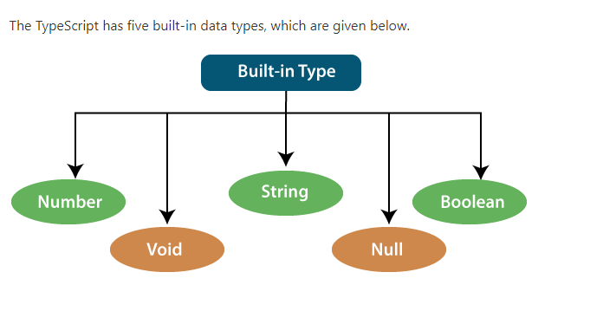
Built-in or Primitive Type

Slide 24
Number
Like JavaScript, all the numbers in TypeScript are stored as floating-point values. These numeric values are treated like a number data type. The numeric data type can be used to represents both integers and fractions. TypeScript also supports Binary(Base 2), Octal(Base 8), Decimal(Base 10), and Hexadecimal(Base 16) literals.
Syntax:
let identifier: number = value;

Slide 25
String
We will use the string data type to represents the text in TypeScript. String type work with textual data. We include string literals in our scripts by enclosing them in single or double quotation marks. It also represents a sequence of Unicode characters. It embedded the expressions in the form of $ {expr}.
Syntax
let identifier: string = " ";
Or
let identifier: string = ' ';

Slide 26
Boolean
The string and numeric data types can have an unlimited number of different values, whereas the Boolean data type can have only two values. They are "true" and "false." A Boolean value is a truth value which specifies whether the condition is true or not.
Syntax
let identifier: BooleanBoolean = Boolean value;
Examples
let isDone: boolean = false;

Slide 27
Void
A void is a return type of the functions which do not return any type of value. It is used where no data type is available. A variable of type void is not useful because we can only assign undefined or null to them. An undefined data type denotes uninitialized variable, whereas null represents a variable whose value is undefined.
Syntax
let unusable: void = undefined;
Examples

Slide 28
Null
Null represents a variable whose value is undefined. Much like the void, it is not extremely useful on its own. The Null accepts the only one value, which is null. The Null keyword is used to define the Null type in TypeScript, but it is not useful because we can only assign a null value to it.
Examples
let num: number = null;
let bool: boolean = null;
let str: string = null;

Slide 29
Undefined
The Undefined primitive type denotes all uninitialized variables in TypeScript and JavaScript. It has only one value, which is undefined. The undefined keyword defines the undefined type in TypeScript, but it is not useful because we can only assign an undefined value to it.
Example
let num: number = undefined;
let bool: boolean = undefined;
let str: string = undefined;

Slide 30
Any Type
It is the "super type" of all data type in TypeScript. It is used to represents any JavaScript value. It allows us to opt-in and opt-out of type-checking during compilation. If a variable cannot be represented in any of the basic data types, then it can be declared using "Any" data type. Any type is useful when we do not know about the type of value (which might come from an API or 3rd party library), and we want to skip the type-checking on compile time.
Syntax
let identifier: any = value;
Examples
let val: any = 'Hi';
val = 555; // OK
val = true; // OK

Slide 31
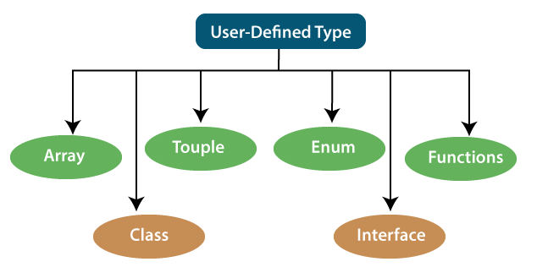
User-Defined DataType
TypeScript supports the following user-defined data types:

Slide 32
Array
An array is a collection of elements of the same data type. Like JavaScript, TypeScript also allows us to work with arrays of values. An array can be written in two ways:
1. Use the type of the elements followed by [] to denote an array of that element type:
var list : number[] = [1, 3, 5];
2. The second way uses a generic array type:
var list : Array<number> = [1, 3, 5];

Slide 33
Touple
The Tuple is a data type which includes two sets of values of different data types. It allows us to express an array where the type of a fixed number of elements is known, but they are not the same. For example, if we want to represent a value as a pair of a number and a string, then it can be written as:
Example :
// Declare a tuple
let a: [string, number];
// Initialize it
a = ["hi", 8, "how", 5]; // OK

Slide 34
Interface
An Interface is a structure which acts as a contract in our application. It defines the syntax for classes to follow, means a class which implements an interface is bound to implement all its members. It cannot be instantiated but can be referenced by the class which implements it. The TypeScript compiler uses interface for type-checking that is also known as "duck typing" or "structural subtyping.“
Example
interface Calc {
subtract (first: number, second: number): any;
}
let Calculator: Calc = {
subtract(first: number, second: number) {
return first - second;
}
}

Slide 35
Class
Classes are used to create reusable components and acts as a template for creating objects. It is a logical entity which store variables and functions to perform operations. TypeScript gets support for classes from ES6. It is different from the interface which has an implementation inside it, whereas an interface does not have any implementation inside it.
Example:
class Student
{
RollNo: number;
Name: string;
constructor(_RollNo: number, Name: string)
{
this.RollNo = _rollNo;
this.Name = _name;
}
showDetails()
{
console.log(this.rollNo + " : " + this.name);
}
}

Slide 36
Enums
Enums define a set of named constant. TypeScript provides both string-based and numeric-based enums. By default, enums begin numbering their elements starting from 0, but we can also change this by manually setting the value to one of its elements. TypeScript gets support for enums from ES6.
Example
enum Color {
Red, Green, Blue
};
let c: Color;
ColorColor = Color.Green;

Slide 37
Functions
A function is the logical blocks of code to organize the program. Like JavaScript, TypeScript can also be used to create functions either as a named function or as an anonymous function. Functions ensure that our program is readable, maintainable, and reusable. A function declaration has a function's name, return type, and parameters.
Example
//named function with number as parameters type and return type
function add(a: number, b: number): number {
return a + b;
}
//anonymous function with number as parameters type and return type
let sum = function (a: number, y: number): number {
return a + b;
};

Slide 38
Generic
Generic is used to create a component which can work with a variety of data type rather than a single one. It allows a way to create reusable components. It ensures that the program is flexible as well as scalable in the long term. TypeScript uses generics with the type variable <T> that denotes types. The type of generic functions is just like non-generic functions, with the type parameters listed first, similarly to function declarations.
Example
function identity<T>(arg: T): T {
return arg;
}
let output1 = identity<string>("myString");
let output2 = identity<number>( 100 );

Slide 39
Decorators
A decorator is a special of data type which can be attached to a class declaration, method, property, accessor, and parameter. It provides a way to add both annotations and a meta-programing syntax for classes and functions. It is used with "@" symbol.
A decorator is an experimental feature which may change in future releases. To enable support for the decorator, we must enable the experimentalDecorators compiler option either on the command line or in our tsconfig.json.
Example
function f() {
console.log("f(): evaluated");
return function (target, propertyKey: string, descriptor: PropertyDescriptor) {
console.log("f(): called");
}
}
class C {
@f()
method() {}
}

Slide 40
Null
Null
Null is used to represent an intentional absence of value. It represents a variable whose value is undefined. It accepts only one value, which is null. The Null keyword is used to define the Null type in TypeScript, but it is not useful because we can only assign a null value to it.
Example
//Variable declared and assigned to null
var a = null;
console.log( a ); //output: null
console.log( typeof(a) ); //output: object

Slide 41
Undefined
It represents uninitialized variables in TypeScript and JavaScript. It has only one value, which is undefined. The undefined keyword defines the undefined type in TypeScript, but it is not useful because we can only assign an undefined value to it.
Example
//Variable declaration without assigning any value to it
var a;
console.log(a); //undefined
console.log(typeof(a)); //undefined
console.log(undeclaredVar); //Uncaught ReferenceError: undeclaredVar is not defined

Slide 42
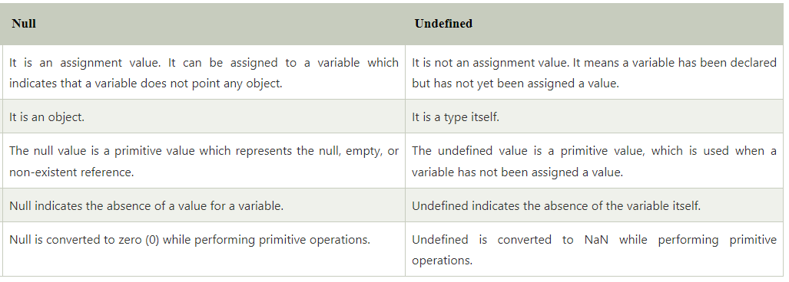
Null vs. Undefined

Slide 43
TypeScript Variables
A variable is the storage location, which is used to store value/information to be referenced and used by programs. It acts as a container for value in code and must be declared before the use. We can declare a variable by using the var keyword. In TypeScript, the variable follows the same naming rule as of JavaScript variable declaration. These rules are-
The variable name must be an alphabet or numeric digits.
The variable name cannot start with digits.
The variable name cannot contain spaces and special character, except the underscore(_) and the dollar($) sign.
In ES6, we can define variables using let and const keyword.
Recommended to define a variable using let keyword because it provides the type safety

Slide 44
Variable Declaration
We can declare a variable in one of the four ways
1. Declare type and value in a single statement
var [identifier] : [type-annotation] = value;
2. Declare type without value. Then the variable will be set to undefined.
var [identifier] : [type-annotation];
3. Declare its value without type. Then the variable will be set to any.
var [identifier] = value;
4. Declare without value and type. Then the variable will be set to any and initialized with undefined.
var [identifier];

Slide 45
Hoisting
Hoisting of var
Hoisting is a mechanism of JavaScript. In hoisting, variables and function declarations are moved to the top of their enclosing scope before code execution.
Note: Hoisting does not happen if we initialize the variable.

Slide 46
Hoisting of let
A variable declared with let keyword is not hoisted. If we try to use a let variable before it is declared, then it will result in a ReferenceError.
Example:
{
//program doesn't know about variable b so it will give me an error.
console.log(b); // ReferenceError: b is not defined
let b = 3;
}

Slide 47
const declarations
The const declaration is used to declare permanent value, which cannot be changed later. It has a fixed value. The const declaration follows the same scoping rules as let declaration, but we cannot re-assign any new value to it.
What will happen when we try to re-assign the const variable?
If we try to re-assign the existing const variable in a code, the code will throw an error. So, we cannot re-assign any new value to an existing const variable.
Output will be as ,
SyntaxError: Identifier 'VAR' has already been declared.

Slide 48
var keyword
The var statement is used to declare a variable in JavaScript. A variable declared with the var keyword is defined throughout the program.

Slide 49
let keyword
The let statement is used to declare a local variable in TypeScript. It is similar to the var keyword, but it has some restriction in scoping in comparison of the var keyword. The let keyword can enhance our code readability and decreases the chance of programming error. A variable declared with the let keyword is limited to the block-scoped only.

Slide 50
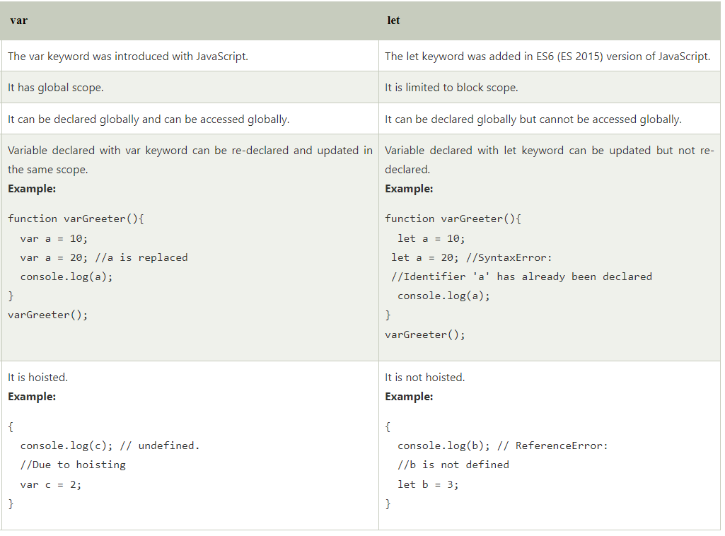
Var vs. Let Keyword

Slide 51
Operators in TypeScript
TypeScript, an operator can be classified into the following ways.
Arithmetic operators
Comparison (Relational) operators
Logical operators
Bitwise operators
Assignment operators
Ternary/conditional operator
Concatenation operator
Type Operator

Slide 52
Arithmetic Operators
Arithmetic operators take numeric values as their operands, performs an action, and then returns a single numeric value. The most common arithmetic operators are addition(+), subtraction(-), multiplication(*), and division(/).

Slide 53
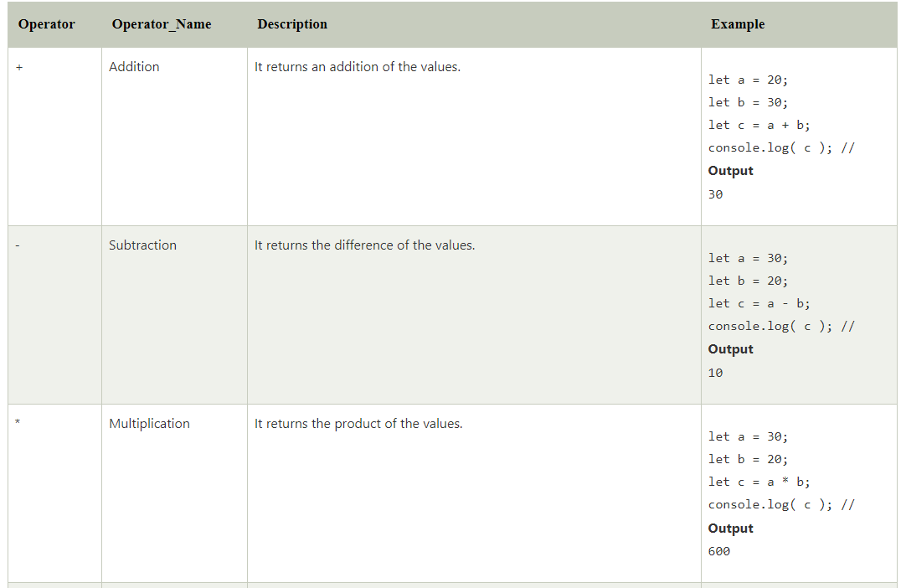
Arithmetic Operators

Slide 54
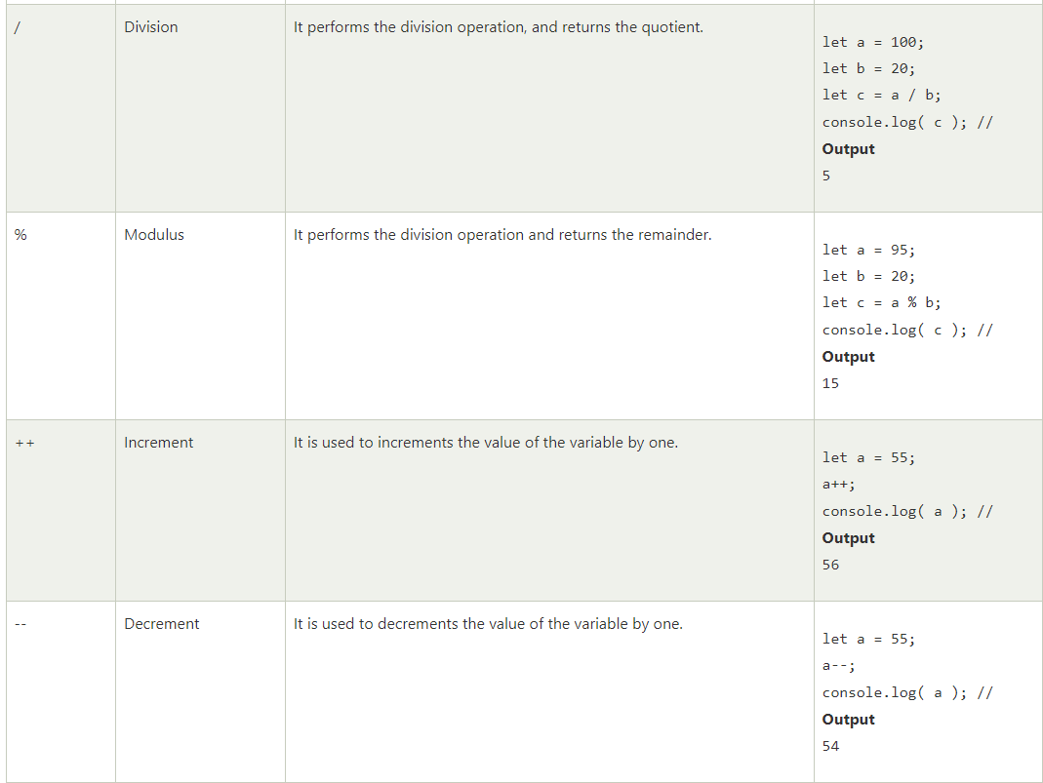
Arithmetic Operators

Slide 55
Comparison (Relational) Operators
The comparison operators are used to compares the two operands. These operators return a Boolean value true or false.

Slide 56
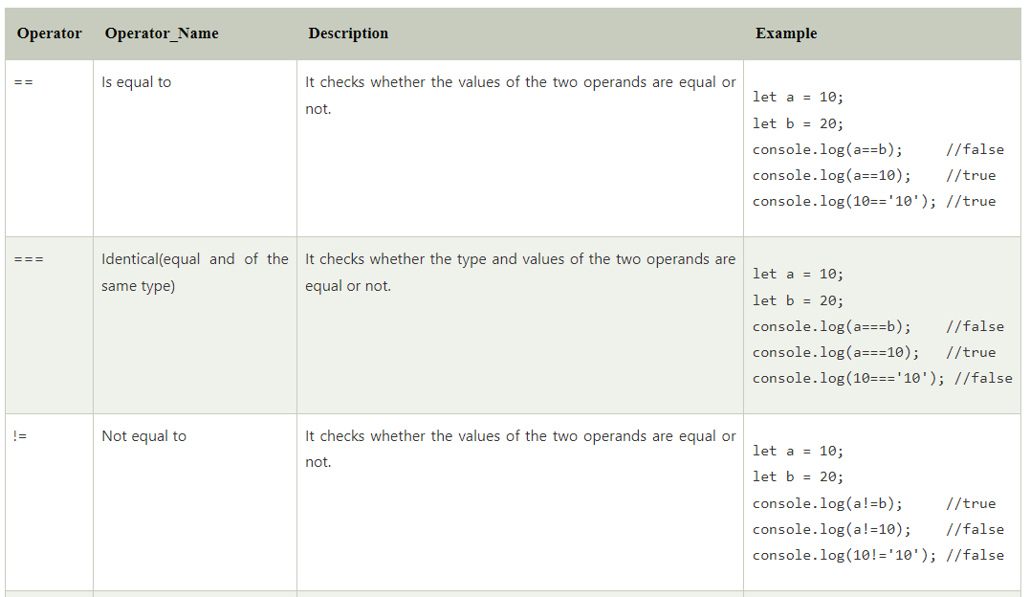
Comparison (Relational) Operators

Slide 57
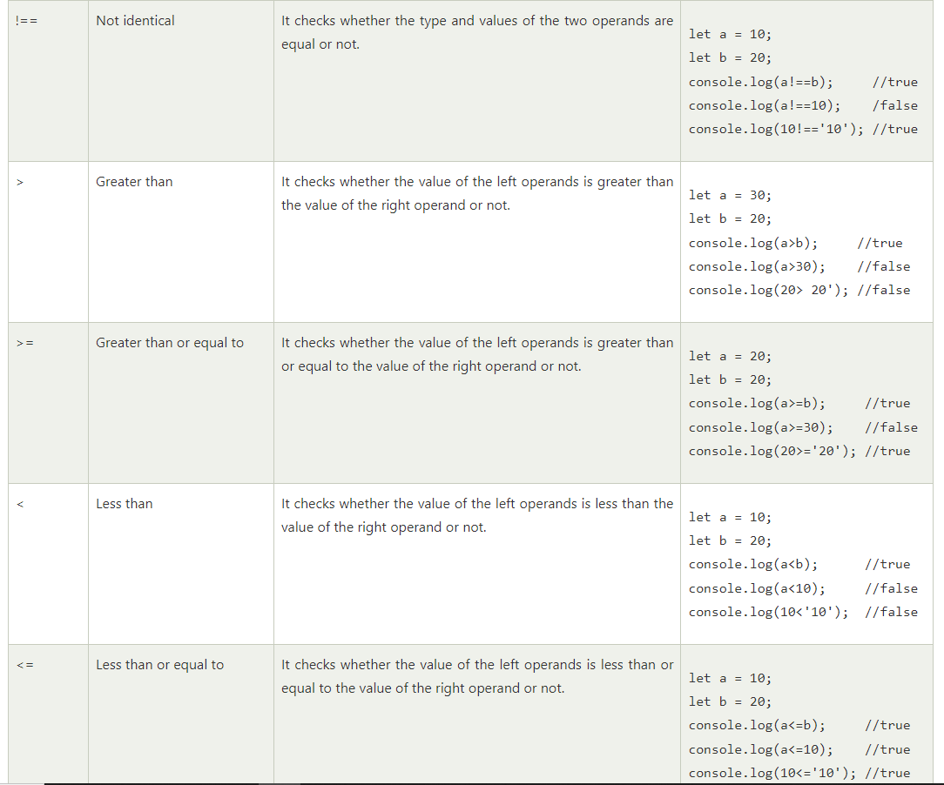
Comparison (Relational) Operators

Slide 58
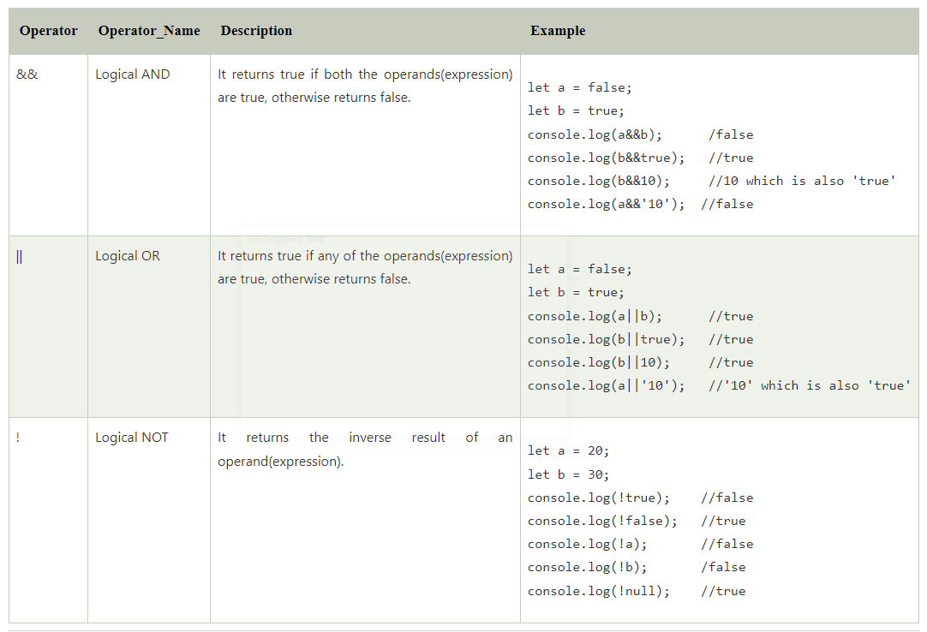
Logical Operators
Logical operators are used for combining two or more condition into a single expression and return the Boolean result true or false.

Slide 59
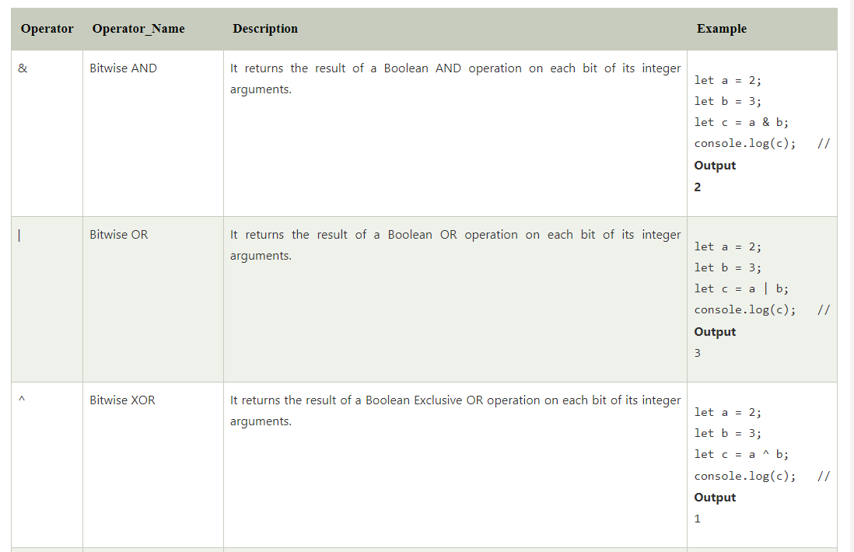
Bitwise Operators
The bitwise operators perform the bitwise operations on operands.

Slide 60
TypeScript Arrays
An array is a homogenous collection of similar type of elements which have a contiguous memory location.
Characteristics of an Array
An array stores elements which have the same data type.
Array elements stored in contiguous memory locations.
The storage of 2-D array elements is rowed by row in a contiguous memory location.
Array name represents the address of the starting element.
The size of an array should be initialized at the declaration time.
Array size should be a constant expression and not a variable.
We can retrieve array elements by specifying the element's corresponding index value.

Slide 61
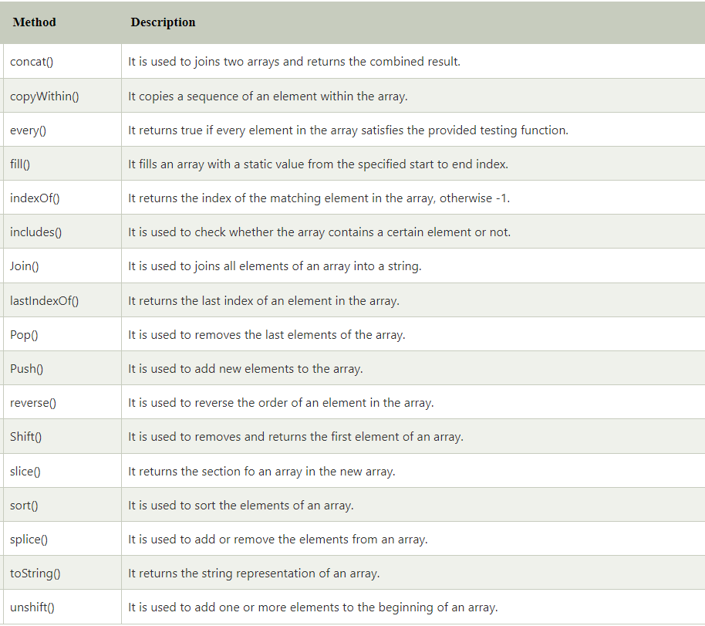
Array Methods

Slide 62
TypeScript String
string is an object which represents the sequence of character values. It is a primitive data type which is used to store text data.
There are three ways in which we can create a string.
1. Single quoted strings
2. Double quoted strings
3. Back-ticks strings

Slide 63
TypeScript Numbers
All the numbers in TypeScript are stored as floating-point values. These numeric values are treated like a number data type. The number is used to represents both integers as well as floating-point values. The number type converts the numeric literal to an instance of the number class. The number class acts as a wrapper and manipulate the numeric literals as they were objects. TypeScript also supports Binary(Base 2), Octal(Base 8), Decimal(Base 10), and Hexadecimal(Base 16) literals.
Syntax
let identifier: number = value;

Slide 64
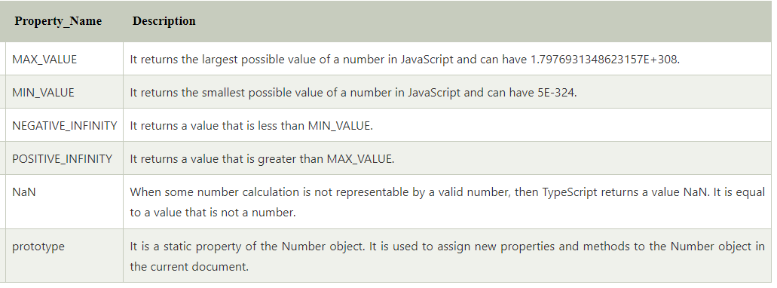
Number Properties

Slide 65
Decision Making
There are various types of Decision making in TypeScript:
if statement
if-else statement
if-else-if ladder
nested if statement

Slide 66
TypeScript forEach
The forEach() method is an array method which is used to execute a function on each item in an array. We can use it with the JavaScript data types like Arrays, Maps, Sets, etc. It is a useful method for displaying elements in an array.

Slide 67
TypeScript Access Modifiers
TypeScript access modifiers are of three types. These are:
Public
Private
Protected.

Slide 68
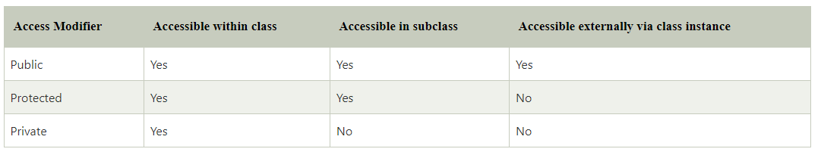

Slide 69
TypeScript Classes
It is a group of objects which have common properties. In terms of OOPs, a class is a template or blueprint for creating objects. It is a logical entity.
A class definition can contain the following properties:
Fields: It is a variable declared in a class.
Methods: It represents an action for the object.
Constructors: It is responsible for initializing the object in memory.
Nested class and interface: It means a class can contain another class.

Slide 70
TypeScript Inheritance
It is a mechanism which acquires the properties and behaviors of a class from another class. The class whose members are inherited is called the base class, and the class that inherits those members is called the derived/child/subclass. In child class, we can override or modify the behaviors of its parent class.

Slide 71
TypeScript Interface
The interface contains only the declaration of the methods and fields, but not the implementation. We cannot use it to build anything. It is inherited by a class, and the class which implements interface defines all members of the interface.
When the Typescript compiler compiles it into JavaScript, then the interface will be disappeared from the JavaScript file. Thus, its purpose is to help in the development stage only.

Slide 72
THANK YOU

